Slide 1
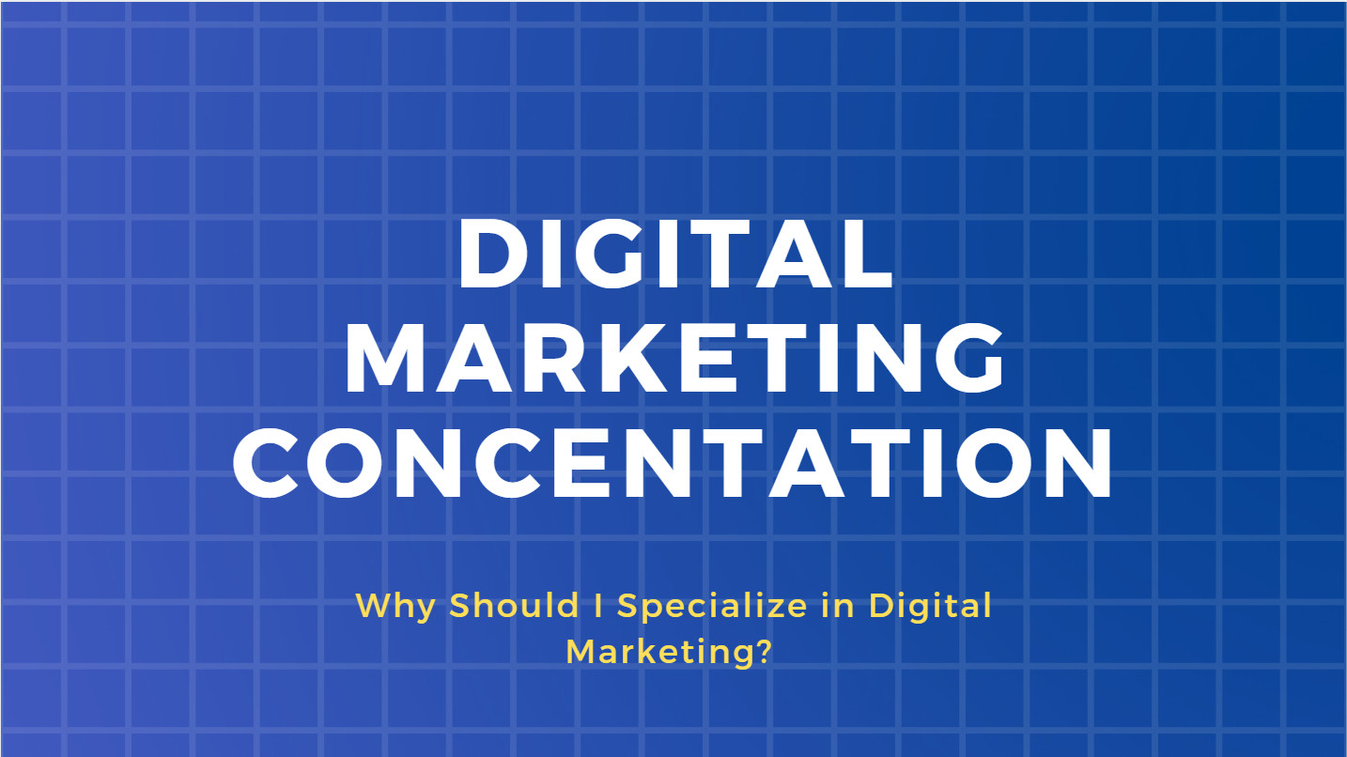

Slide 3
EVERYONE IS ONLINE…
4 billion people online; 3 billion using social media
Average American adult spends 5.9 hours online
45 minutes on social media
Over 80 million small and medium size businesses have a Facebook page

Slide 4
MARKETERS NEED PEOPLE WITH DIGITAL SKILLS

Slide 5
https://www.cnbc.com/2019/01/08/the-25-most-in-demand-technical-skills-of-2019-according-to-linkedin-.html

Slide 6
Types of Digital Marketing Jobs
Digital Marketing Manager
Content Strategist
User Experience Specialist
SEO Specialist
SEM Specialist
Social Media Marketing
VR/AR Developer
Data Analyst
Email Marketing Specialist
Internet of Things Specialist
Bot Specialist

Slide 7
Digital Marketing Job Growth

Slide 10
Atlanta has a Rich Digital Ecosystem!

Slide 11
Digital Marketing Concentration

Slide 12
Digital Marketing Concentration Requirements
Consumer Behavior
Marketing Research
Marketing Management
Digital Marketing
Content and Social Marketing
Digital Analytics
3000-4000 level course OR Digital Internship

Slide 13
Confusion about the Digital Marketing Concentration

Slide 14
A concentration involves more classes than a “normal” marketing degree
Every marketing major (with or without a concentration takes 7 marketing classes – after Principles of Marketing)

Slide 15
I won’t get a marketing degree if I concentrate in digital marketing
You will STILL earn a B.B.A. in Marketing with a Digital Marketing Concentration.
Every marketing major takes the same three core classes: Consumer Behavior, Marketing Research and Marketing Management.

Slide 16
Specializing in a concentration will LIMIT my options
No – quite the opposite; It will differentiate you.
Not that many schools in the nation offer multiple (3+) digital related marketing courses (only 15%!)
Only 1 out of 10 require Digital Marketing
We are part of 2% that require DM + Specialized programs

Slide 17
You can’t teach me anything about social media I don’t already know…
Dependency on social media does no equal proficiency. Using social media personally is very different than for a business.

Slide 18
I don’t have time for an internship
You can do an internship in the summer or during the school year.
If you can’t do an internship you can replace this requirement for a 3000-4000 marketing course (i.e. advertising, retailing, etc.)

Slide 19
Interested in the topic?
Follow #DIGMARUNG
Follow our Social Media Accounts!
DIGMARatUNG

Slide 20
Questions about the program?
Email me!
Dr. Caroline Munoz
Associate Professor of Marketing
Caroline.munoz@ung.edu

